Slide 1
University Admission Prediction
- By
P. Rehitha - 17AK1A0590
K. Prathyusha - 17AK1A0579
J. Sai Sree Vidya - 17AK1A0591
M. Reddy Rani - 17AK1A0589
M. Reshma - 16AK1A0567

Slide 2


Slide 3

why should we use machine learning
In this?

Slide 4
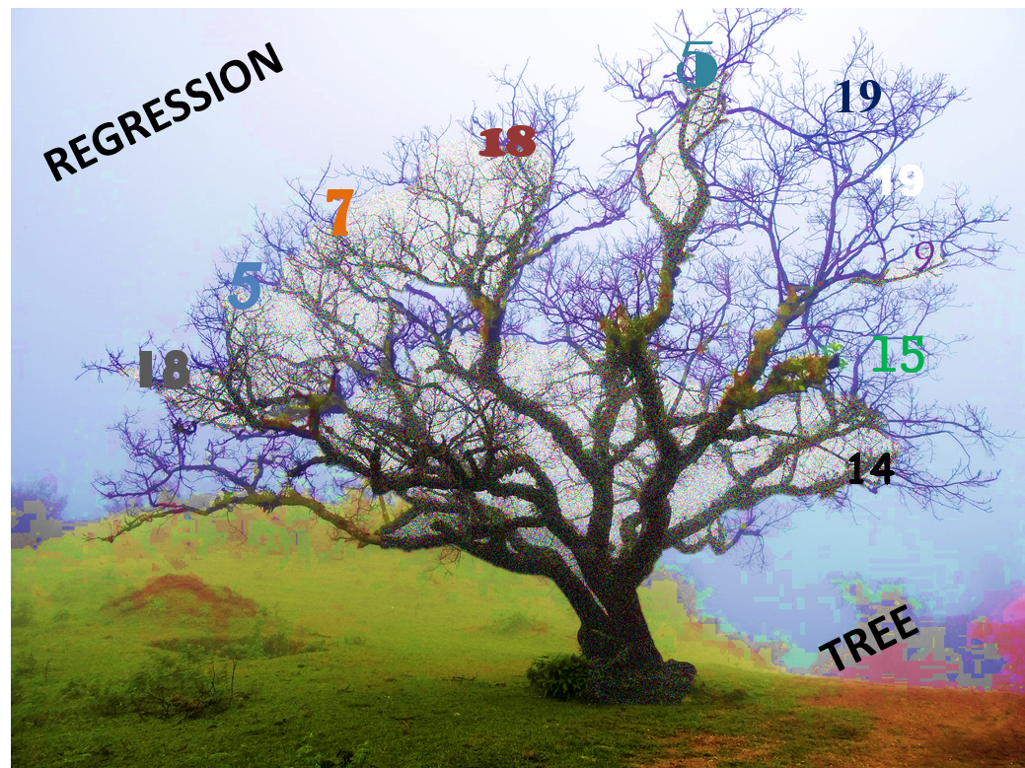
Which Model???
Here we use Decision Tree Regressor
Nonlinear relationships between parameters do not affect tree performance

Slide 5
Decision trees provide an effective method of Decision Making because they:
Nonlinear relationships between parameters do not affect tree performance
Allow us to analyze fully the possible consequences of a decision.
Help us to make the best decisions on the basis of existing information and best guesses.

Slide 6
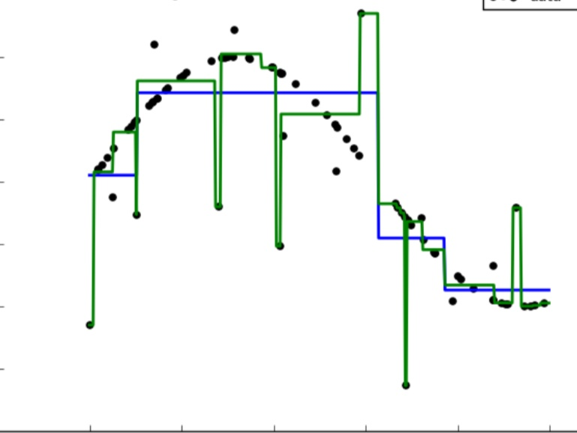

Slide 7
About dataset:
Attributes:
Serial no.
GRE SCORE(Graduate Record Examination score)
TOEFL score(Test of English as a Foreign Language)
University Rating
SOP
LOR
CGPA
Research
Chance of Admit

Slide 8
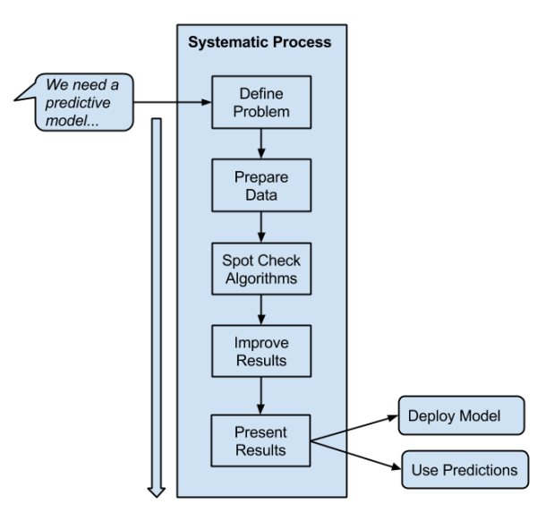

Slide 9
Conclusion

Slide 10
https://sreevidya20.eu-gb.mybluemix.net/ui

Slide 11


